Slide 1
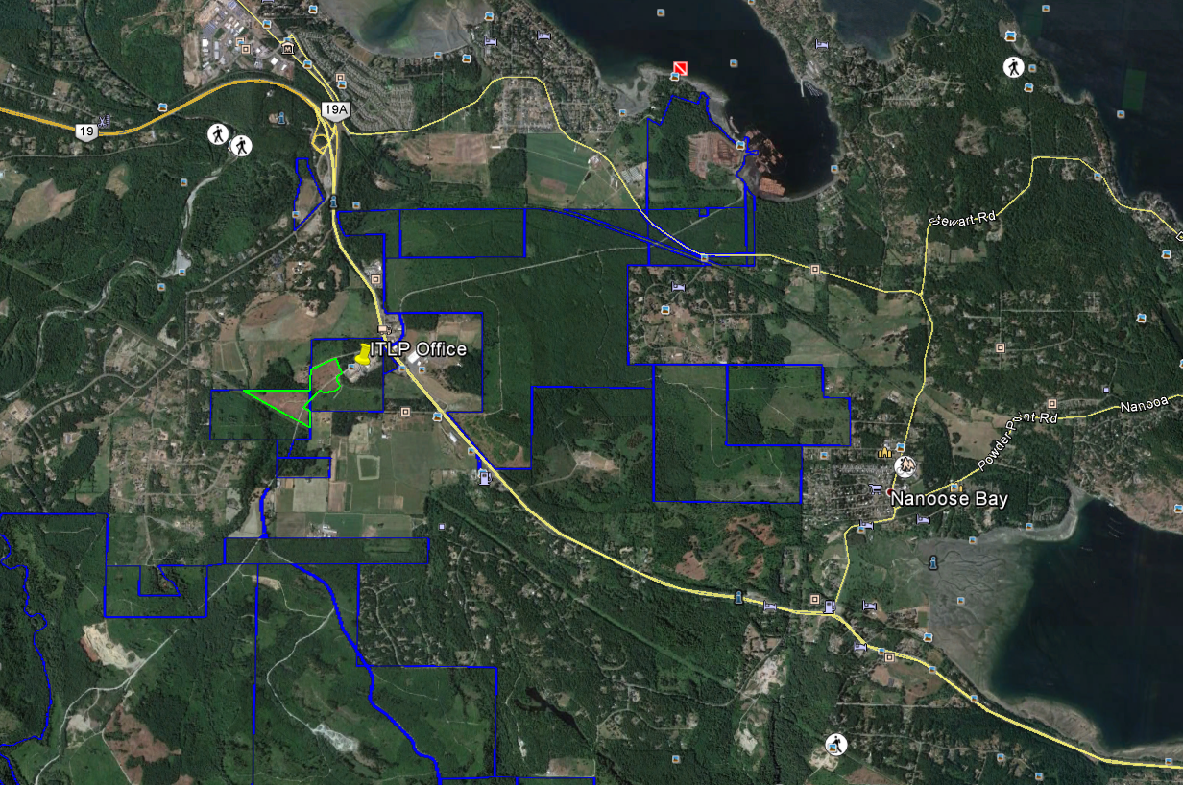

Slide 2
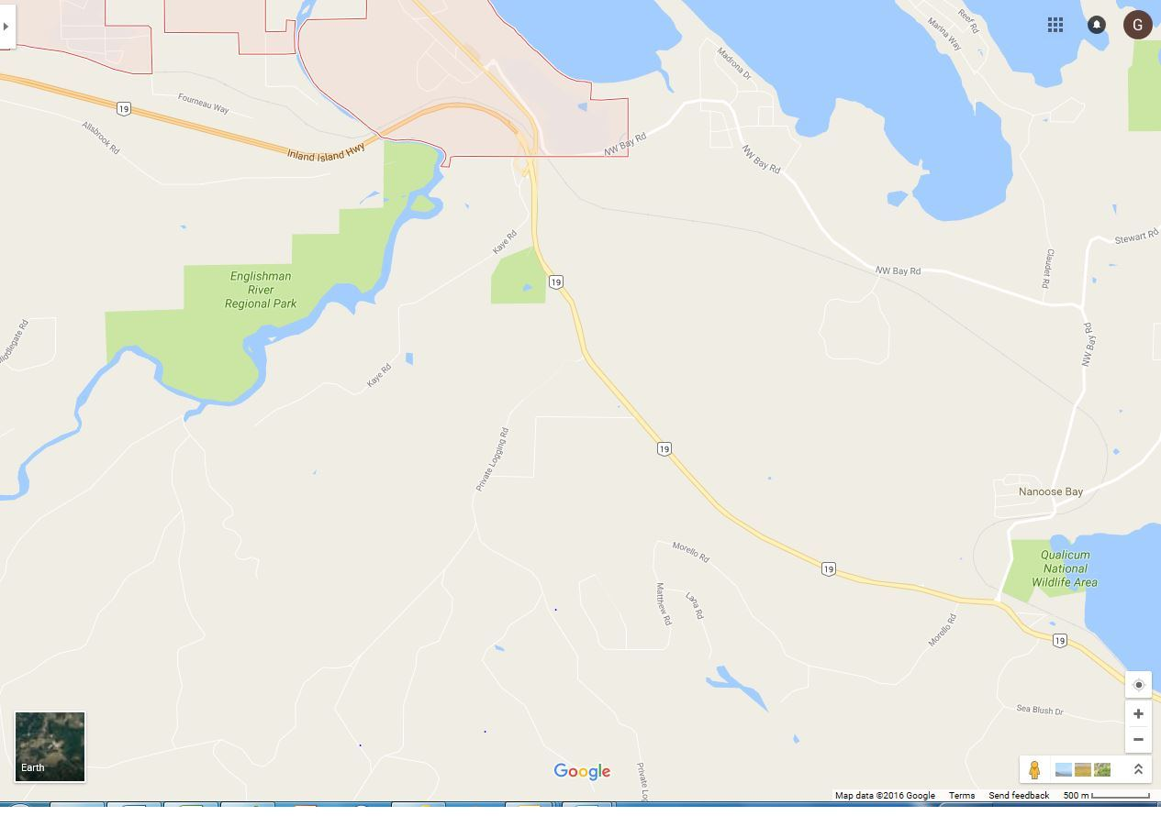
IslandTimberlands office – get Parksville AMAT gate key here.

Slide 3
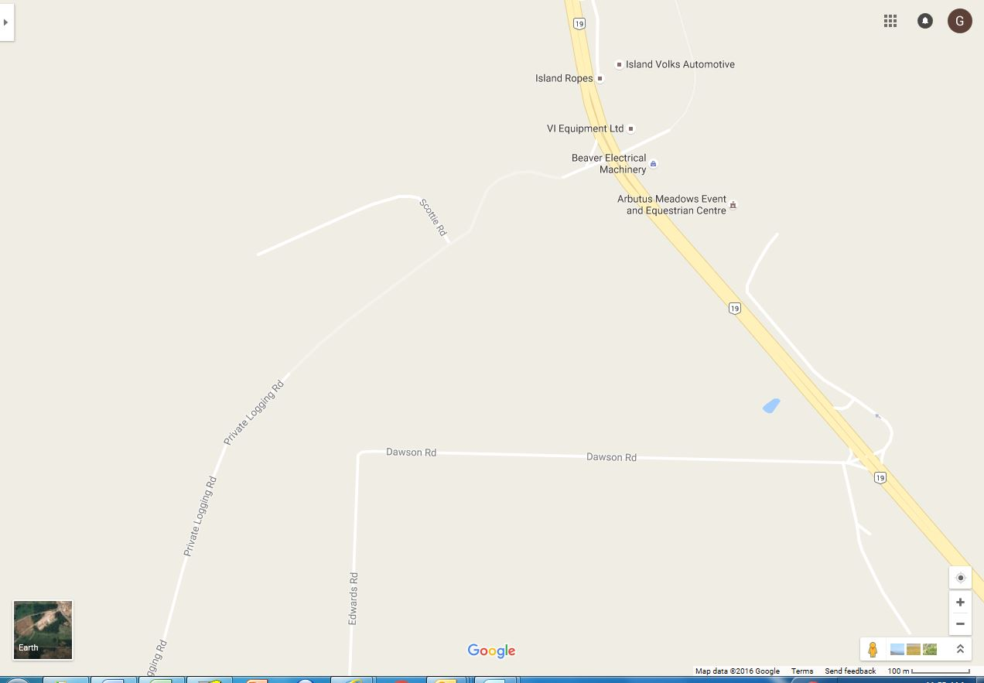
IslandTimberlands office – get Parksville AMAT gate key here.

